Slide 1


Slide 2




Sleep Deprivation
62%
97%
82%
Adults Have Trouble Sleeping
Teenagers Are Sleep Deprived
College Students Lack Sleep

Slide 3

$60.2 Billion
Sleep Aids Market

Slide 4
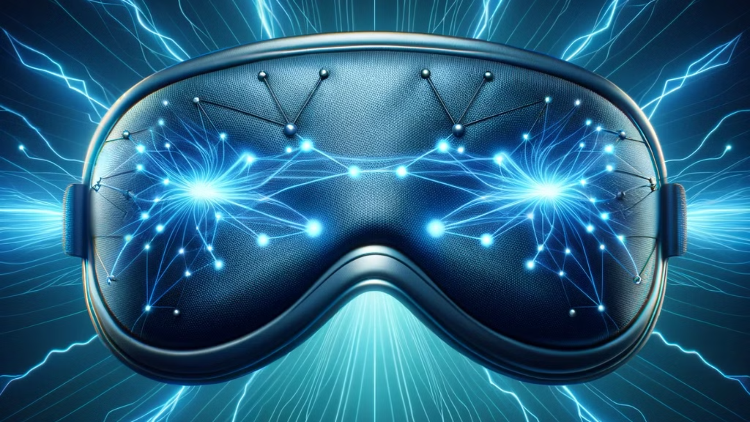


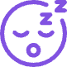
Solution
Minimal Risk
Comfortable & User-Friendly
Improved Sleep Depth and Stability

Slide 5
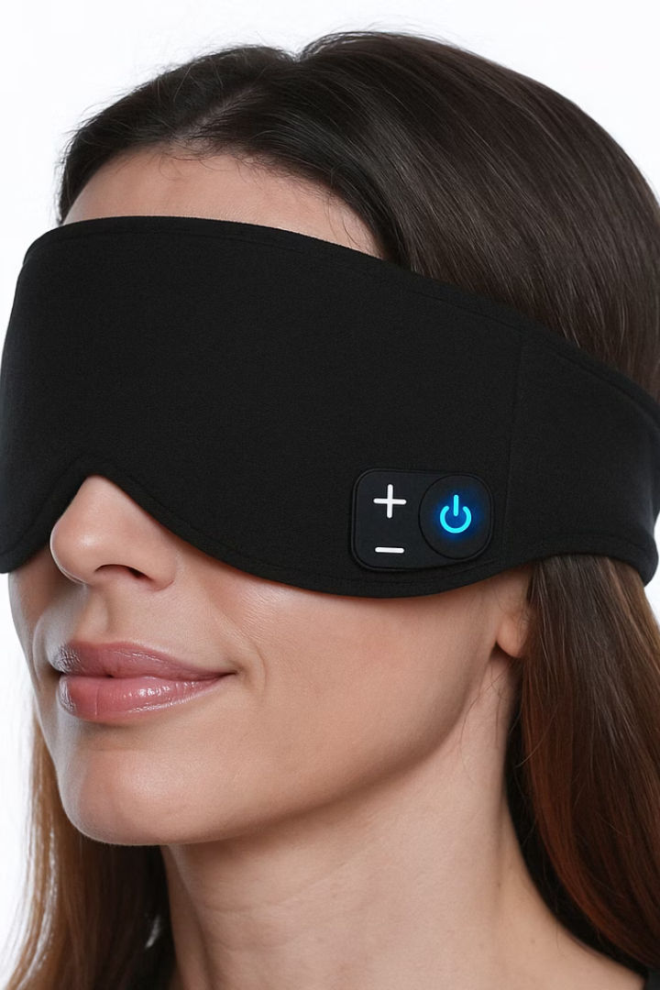
Active Sleep Mask
The only device that helps while sleeping

Slide 6

Neurophysiological Mechanism
Activates the parasympathetic nervous system, lowering stress levels and promoting relaxation.
Stimulates the brain to produce calming alpha waves, aiding in relaxation before sleep.
Increases levels of neurotransmitters that are essential for sleep regulation.
Enhances the production of hormones that generates sleep.

Slide 7
Go To Market
1
Early Adopters POC
2
510(k) - Insomnia
3
Collaboration With Sleep Clinics
4
Distribution Partnerships

Slide 8
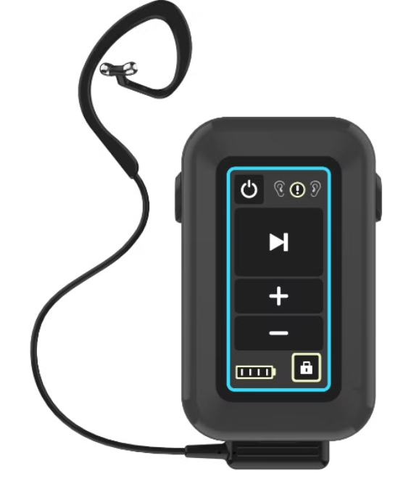
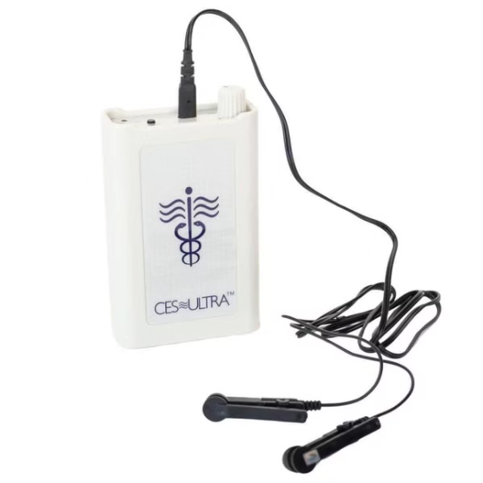
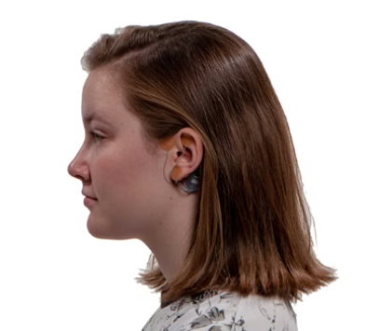
Competitive landscape
Competitor
Product
Treatment
tVNS
Depression, Epilepsy, Migraines, Prader-Willi-Syndrome
CES Ultra
Relieve Anxiety and Insomnia
IB Stim
Opiate Withdrawal

Slide 9




Billion Dollar Roadmap
The Neuromodulation Suite
Concentration
1
Improved focus and productivity for employees
Cognition
2
Enhanced learning and memory
Sleep
3
Better sleep quality for healthier, well-rested teams
Wellbeing
4
Reduced anxiety and depression for happier, more resilient workforces

Slide 10


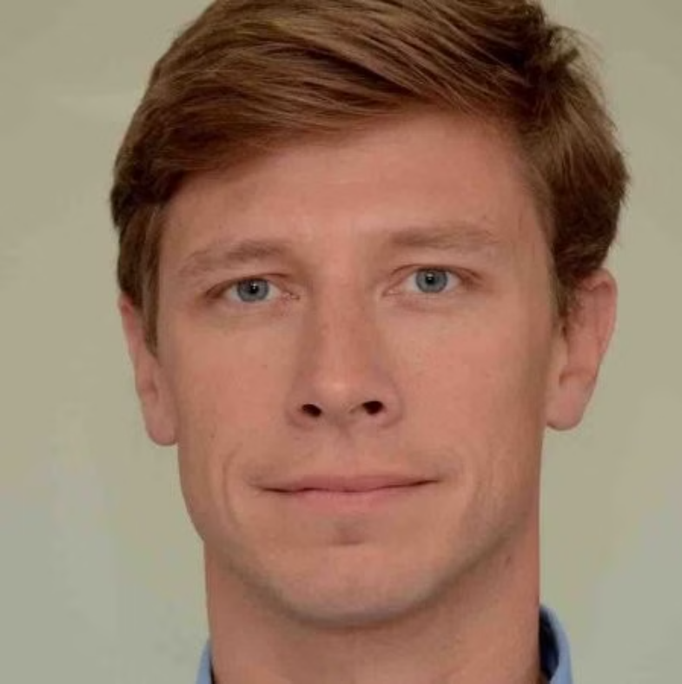

The Team
Medical Experts
Research Specialists
Felix Benninger, MD
Nir Cafri, M.Sc.
Clinical Neurology; Electrophysiological Techniques; Epileptogenesis
Sr. Data Scientist.

Slide 11
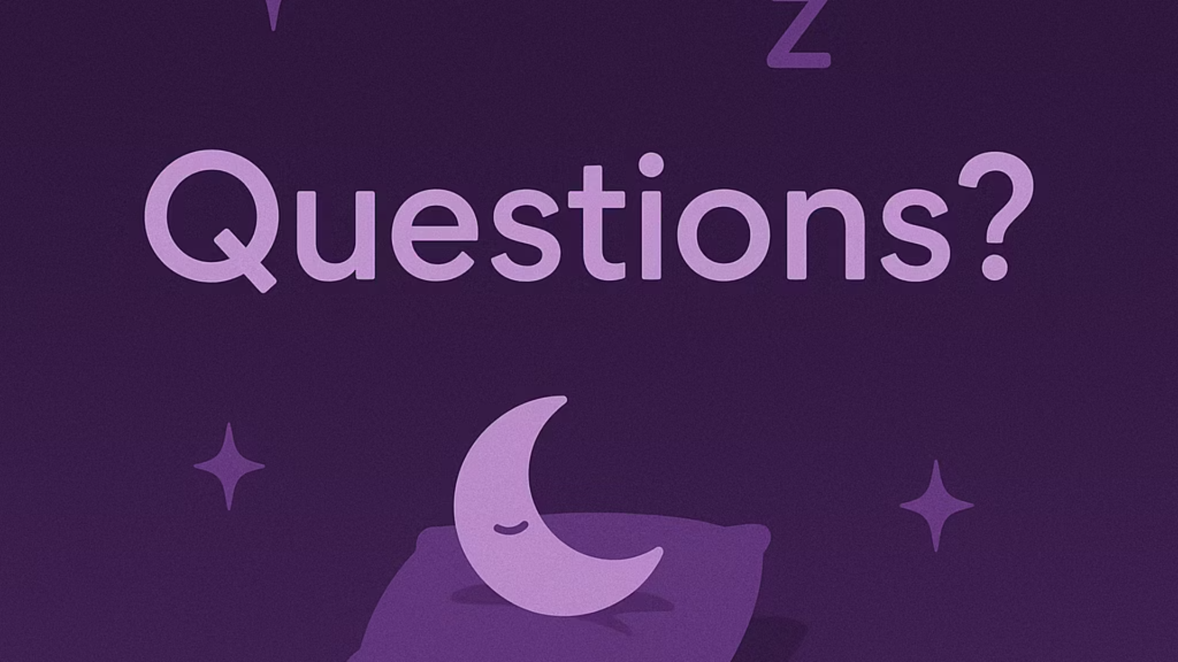

Slide 12
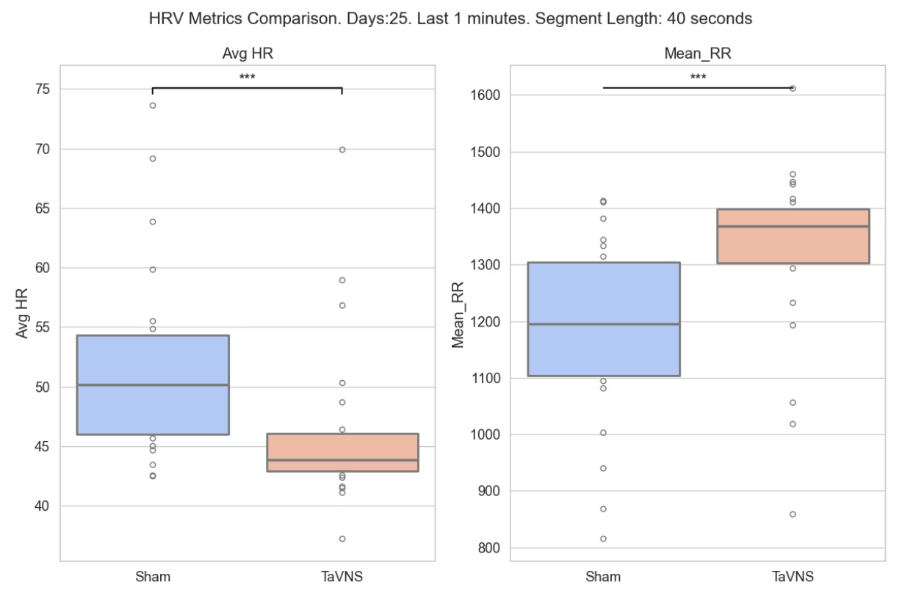

Slide 13
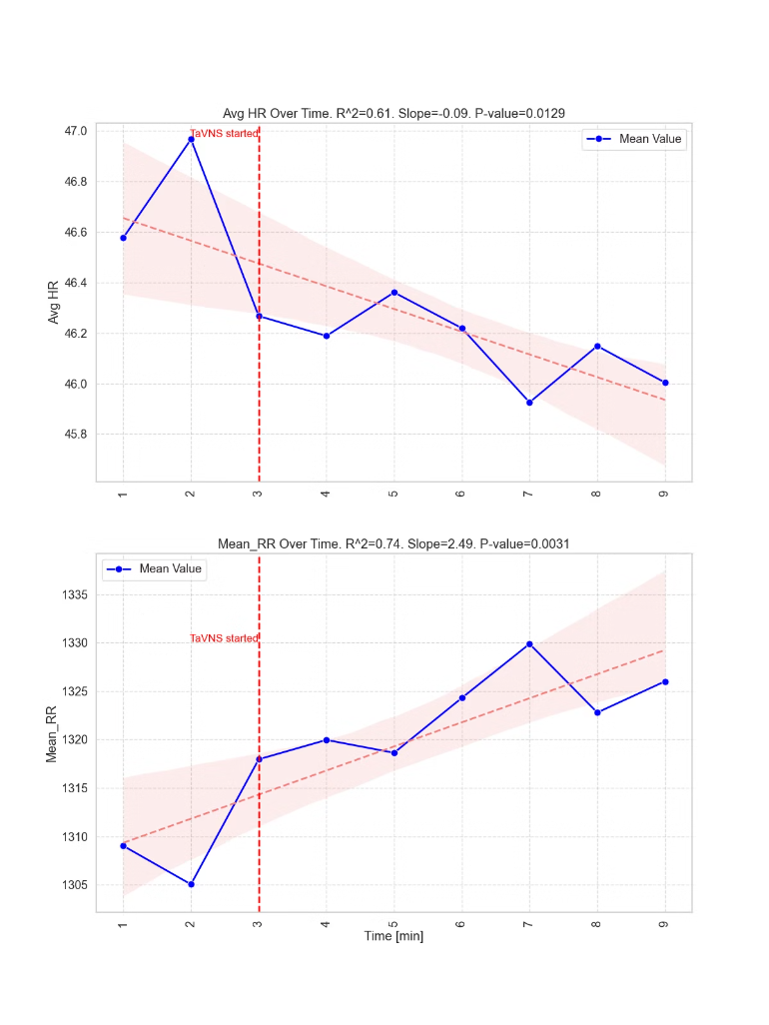

Slide 14





The Team
Medical Experts
Research Specialists
Business Professionals
Felix Benninger, MD
Nir Cafri, M.Sc.
Clinical Neurology; Electrophysiological Techniques; Epileptogenesis
Sr. Data Scientist.

Slide 15
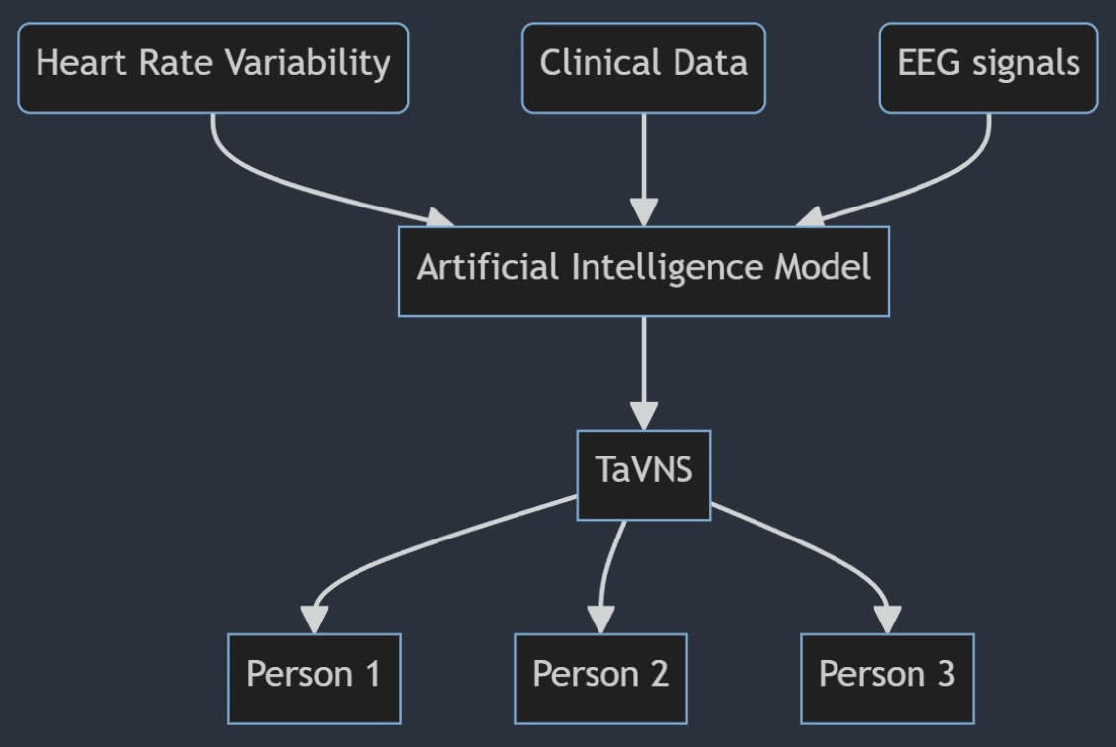
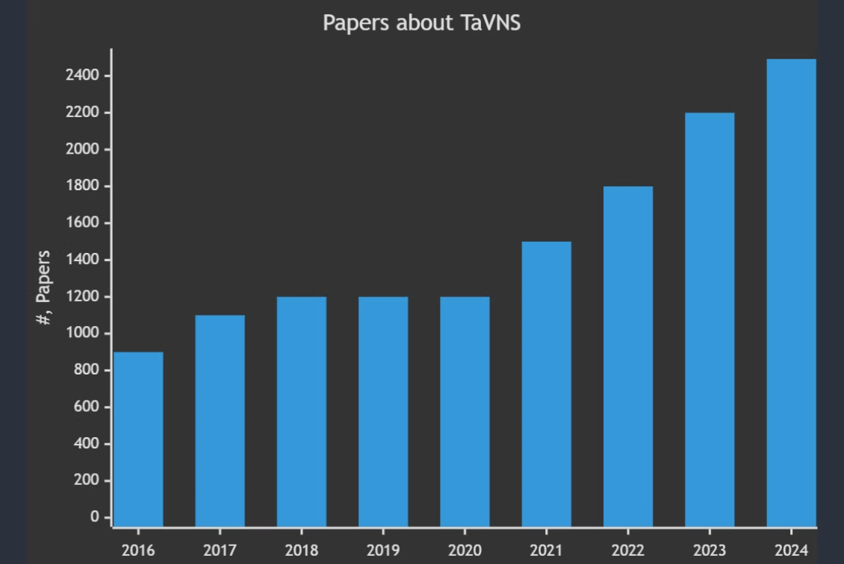
First Personalized tVNS
Integrating heart rate variability (HRV), clinical data, and EEG signals with AI to create a unique IP model. This would be a predictive tool tailored for healthcare applications, enhancing personalized patient treatment plans and possibly advancing diagnostic procedures.

